Slide 1
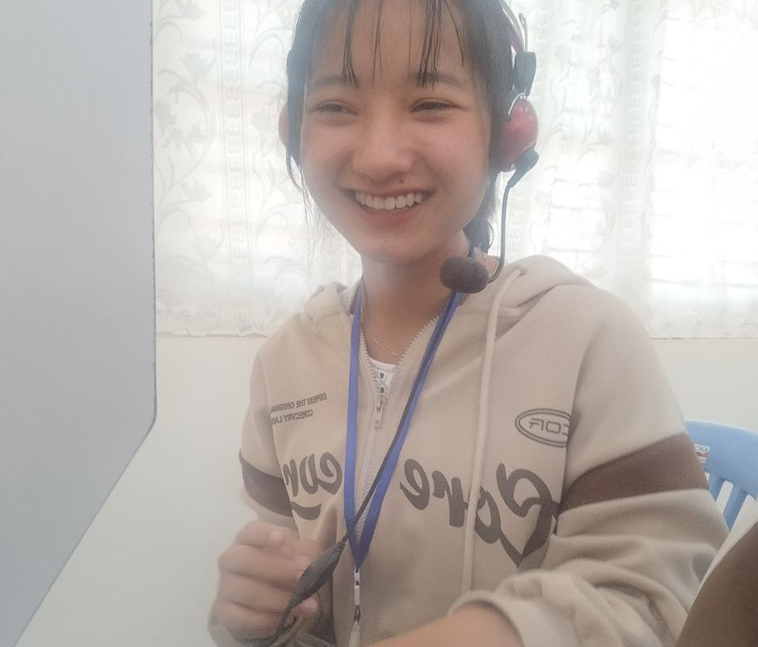
My Student portfolio
Win Hnin Hlaing
Computer Science Student passionate about programming and web design.
winhninhlaing@ucstgi.edu.mm
byuu-byuu.github.io

Slide 2

Agenda
A little bit about me
Education
School Projects
Contact

Slide 3
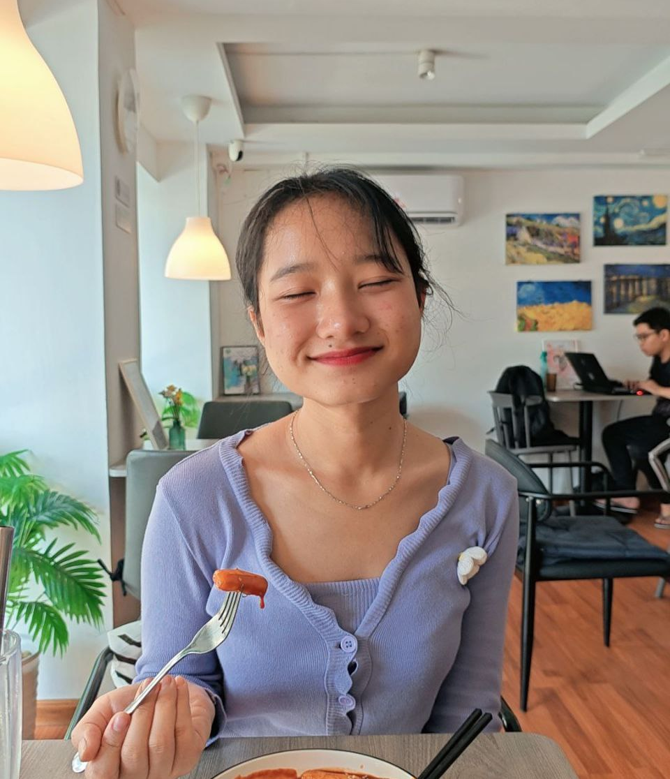
About me
I’m Win Hnin Hlaing, a multidisciplinary creative with a passion for networking and web development. My journey began with a sketchpad and a curiosity for how we use programming languages to communicate with computer, and how databases store, manipulate, and share the information —and it’s grown into a career devoted to meaningful, impactful creative work.

Slide 4

I am a puzzle lover and I love solving logical problem. Our mission in courses is to design online webpages and to build certain apps for a lot of users . Every project is an opportunity to develop my logical problem-solving skills and to improve my creativity.

Slide 5

Education
University of Computer Science and Technology Undergraduate (Computer Science)
Courses
Object Oriented Programming
HTML
Database Fundamental
Digital Logic and design

Slide 6



Skills
Programming: C++, HTML, CSS
Databases: MySQL
Tools: VS Code, NotePad, CodeBlocks, MySQL, Multisim 11.0
(first year of computer science and technology)

Slide 7
School Projects
Online Learning Classes(HTML group project)
Designed a webpage for the online language classes.
Included pages i.e., Home, Enroll Now, About Us, Sign Up, Help. .
C++
Array and String
C++ using structure
C++ using Function
C++ using Pointer
File
Databases
Databases for customers, sales and products.
Relational Algebra
Normalization

Slide 8

Contact
09-697297218 winhninhlaing@ucstgi.edu.mm
byuu-byuu.github.io

